Slide 1


ECEN 361
Real-Time and Embedded Systems
IOT - Information - Sampling
Notes:
&&& Need to add more to this lecture – not enough meat

Slide 2
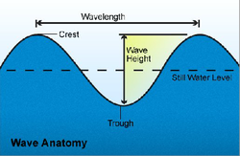
Wave in Distance

Slide 3
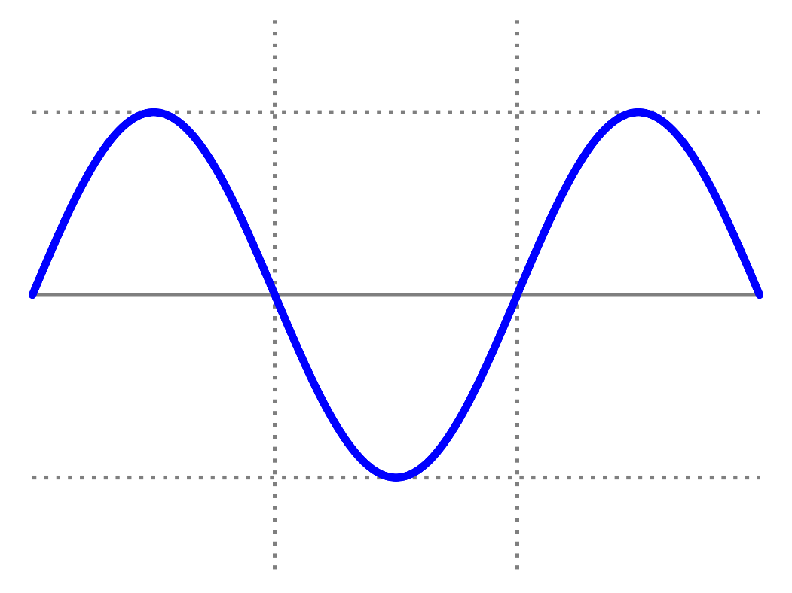

Wave in Time
height
time

Slide 4
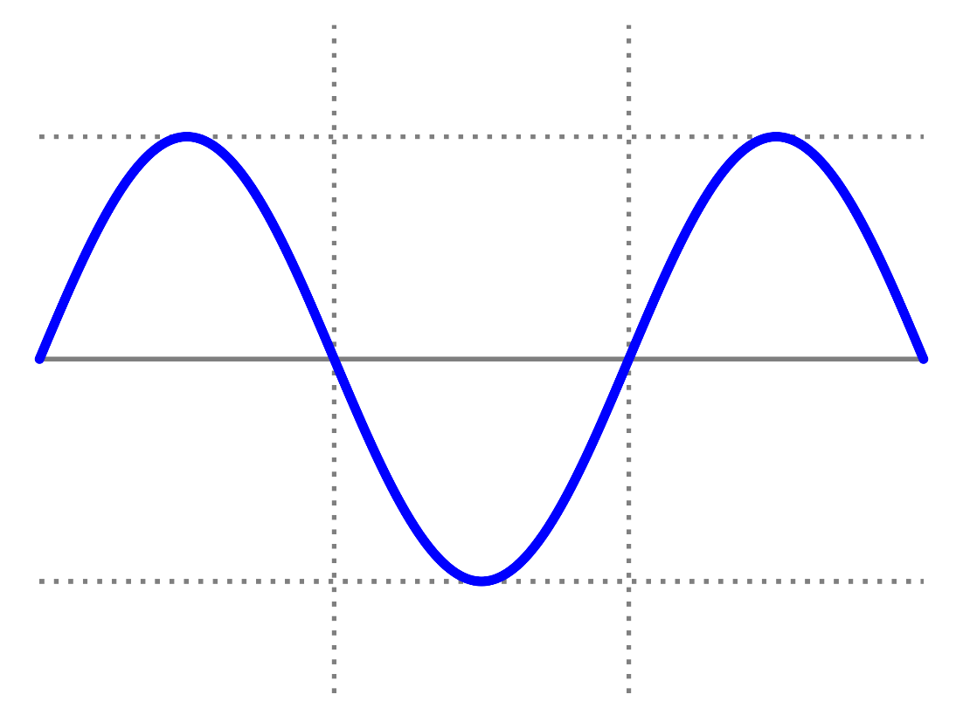
Storing Information in the Computer
height
Can we store this in the computer?
time

Slide 5
Storing Information in the Computer
height
What if I want to analyze the information?
time

Slide 6
Storing Information in the Computer
height
wave[] = 0, 3, 5, 7, 8, 9, 8, 7, 5, 3, 0, …
time

Slide 7
Sampling x(t)
What is sampling?
Sampling Process
Convert x(t) to numbers x[n]
“n” is an integer; x[n] is a sequence of values
Think of “n” as the storage address in memory
Uniform Sampling at t = nT_{s}
ideal: x[n] = x(nT_{s})
x(t)
A-to-D
x[n]

Slide 8
Sampling Rate, f_{s}
Sampling Rate (f_{s})?
f_{s} =1/T_{s}
Number of Samples per Second
T_{s} = 125 microsec → f_{s} =
Units are Hertz: 8000 Hz
Uniform Sampling at t = nT_{s} = n/f_{s}
ideal: x[n] = x(nT_{s})=x(n/f_{s})
8000 samples/sec
x[n]=x(nT_{s})
x(t)
A-to-D

Slide 9
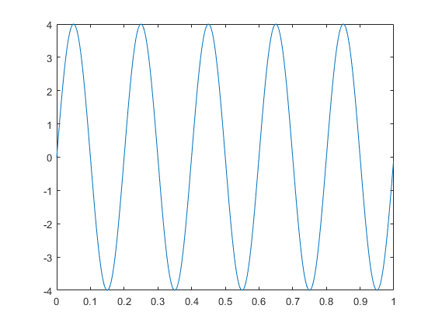
Sampling Example

Slide 10
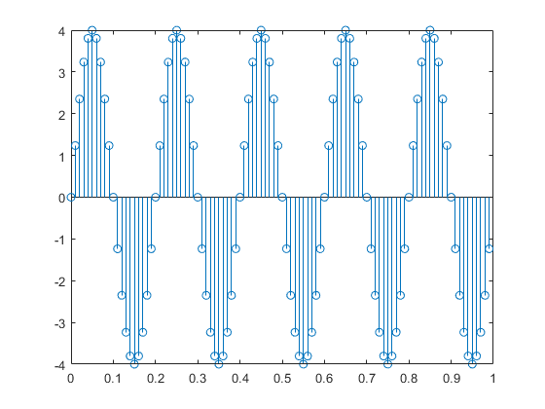
Sampling Example

Slide 11
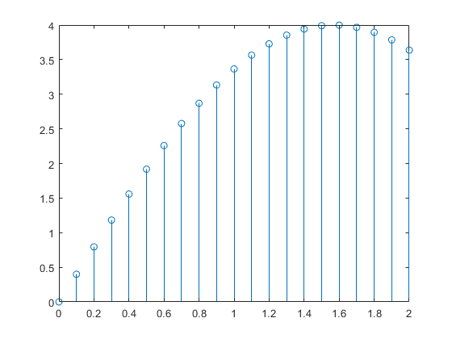
Sampling Example

Slide 12
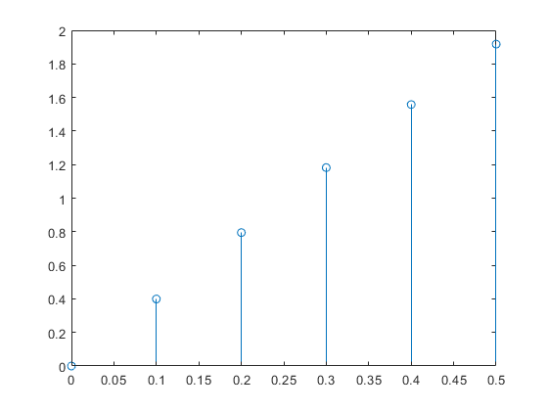
Sampling Example
What does the data look like?
x[n] = {0.4, 0.8, 1.2, 1.5, 1.96} ?
x[n] = {204, 408, 612, 1536, 2007}

Slide 13
Sampling Example
What does time look like?
0.1 seconds

Slide 14
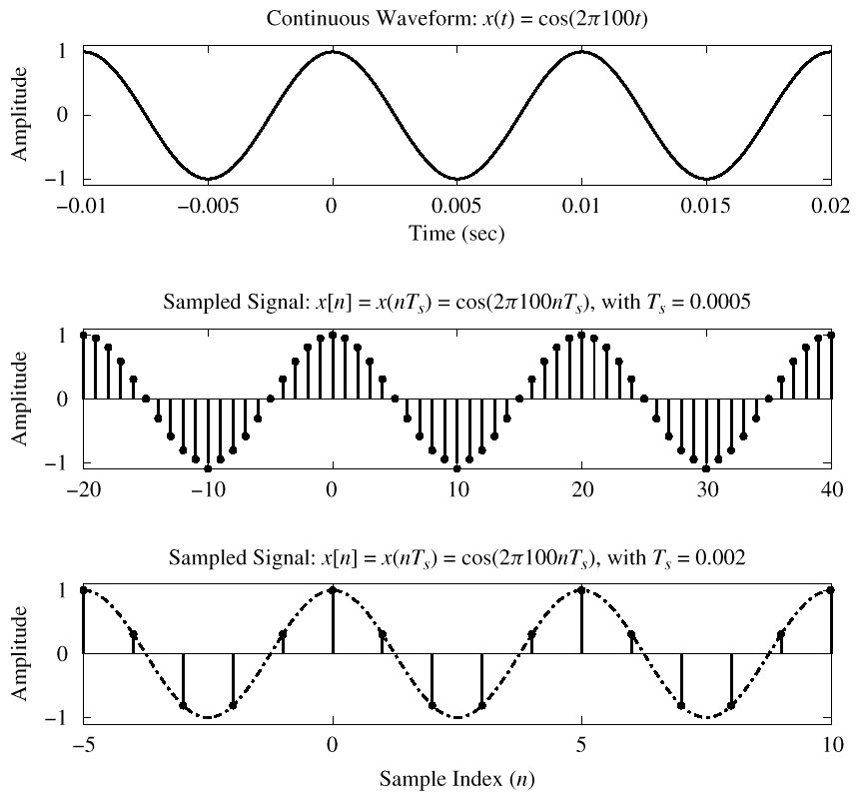
Sampling Example
How many samples/period do we get?
f_{s}/f = samp/period
20 samp/period
5 samp/period

Slide 15
Digital Frequency
varies from 0 to 2π, as f varies from 0 to the sampling frequency
Units are radians, not rad/sec
Digital Frequency is Normalized

Slide 16
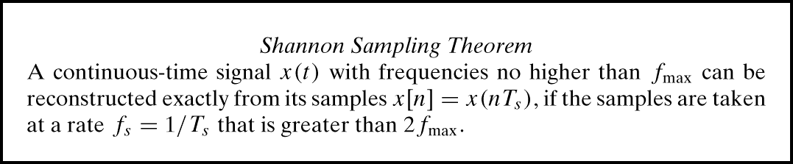
Sampling Theorem
So, how often should we sample?
Depends on the frequency of the signal
Answered by Shannon/Nyquist Theorem
Also depends on reconstruction needs

Slide 17
Digital Sound
x(t) is a Black Eye Pea song (or Mormon Tabernacle Choir ☺)
How fast should we sample it?
Audio CD
CD rate is 44,100 samples per second
16-bits/sample
Stereo - uses 2 channels
Number of bytes for 1 minute of the song?
2 * (16/8) * 60 * 44100 = 10.584 Mbytes
What happens if we don’t sample at ≥ 2f_{max}?

Slide 18
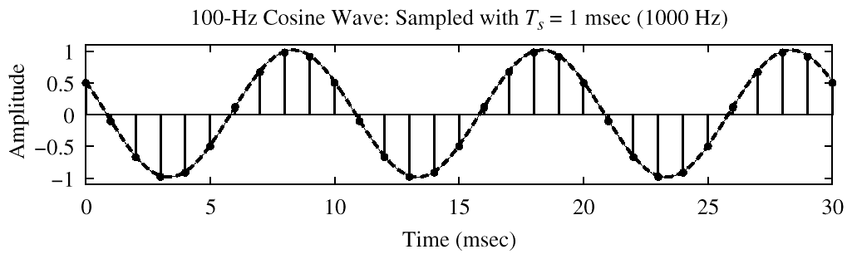
Spectrum of a Digital Signal
What does this mean?
–0.2π
2π(0.1)

Slide 19
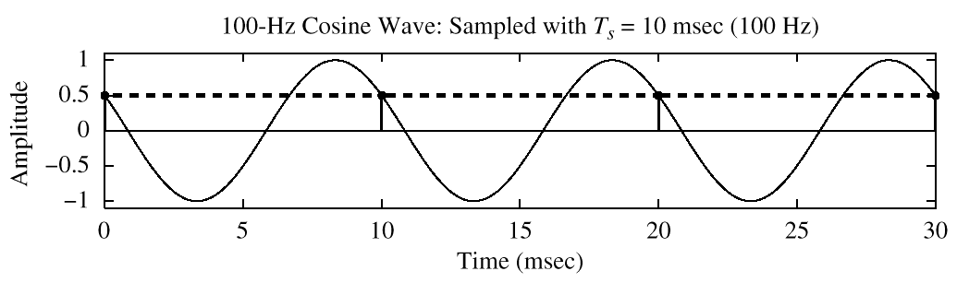
Another Digital Spectrum What does this mean?
?
–2π
2π(1)
x[n] is zero frequency???

Slide 20
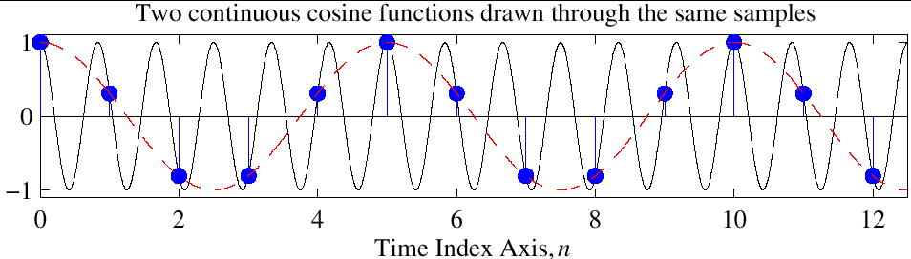
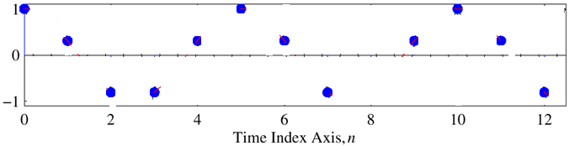
Reconstruction?
Given the samples, draw a sinusoid through the values

Slide 21
Periodic Spectrum
Spectrum of x[n] has more than one line for each sinusoid
Called Aliasing
Spectrum is periodic with period = 2π
Because

Slide 22
Aliasing Derivation
Other Frequencies give the same

Slide 23
Aliasing Summary
Adding f_{s} or 2f_{s} or –f_{s} to the Freq of x(t) gives exactly the same x[n]
The samples, x[n] = x(n/ f_{s} ) are exactly the same value
Given x[n], we can’t distinguish f_{o} from (f_{o} + f_{s} ) or (f_{o} + 2f_{s} )
Normalized Radian Frequency

